Slide 1
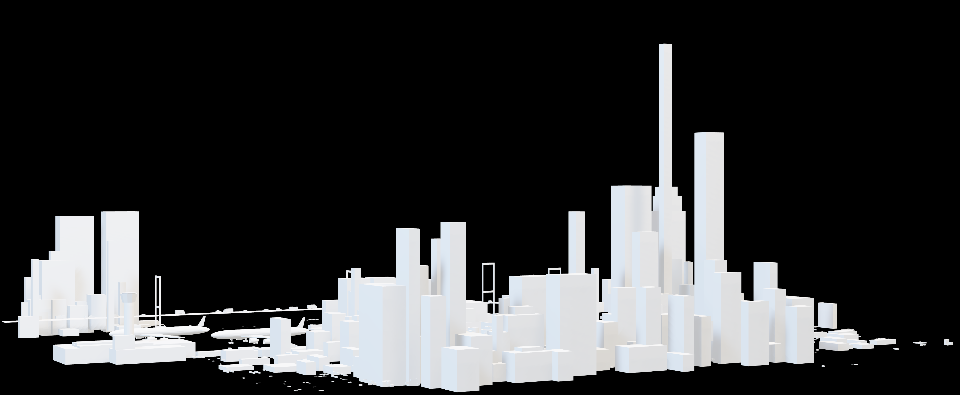
3D CITY
WORLD OF ADVERTISING
SPACIAL SLIDE DECK
WITH LOW POLY 3D ASSETS

Slide 2
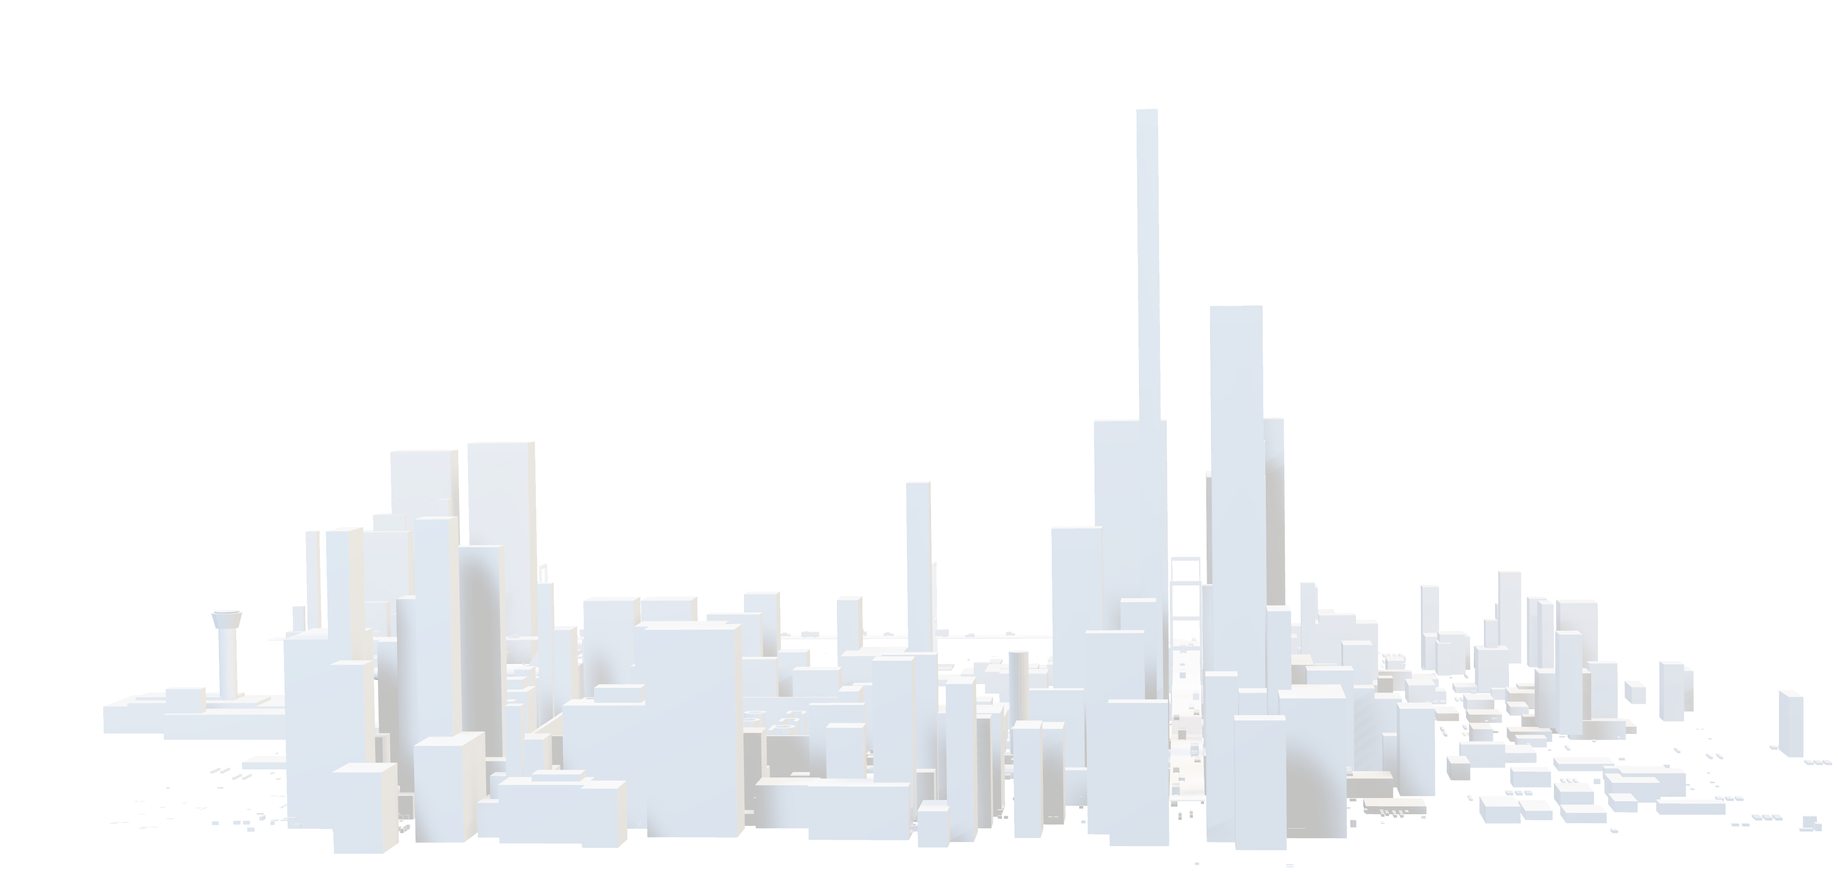
LED Screen
WORLD OF ADVERTISING
SPACIAL SLIDE DECK
WITH LOW POLY 3D ASSETS

Slide 3
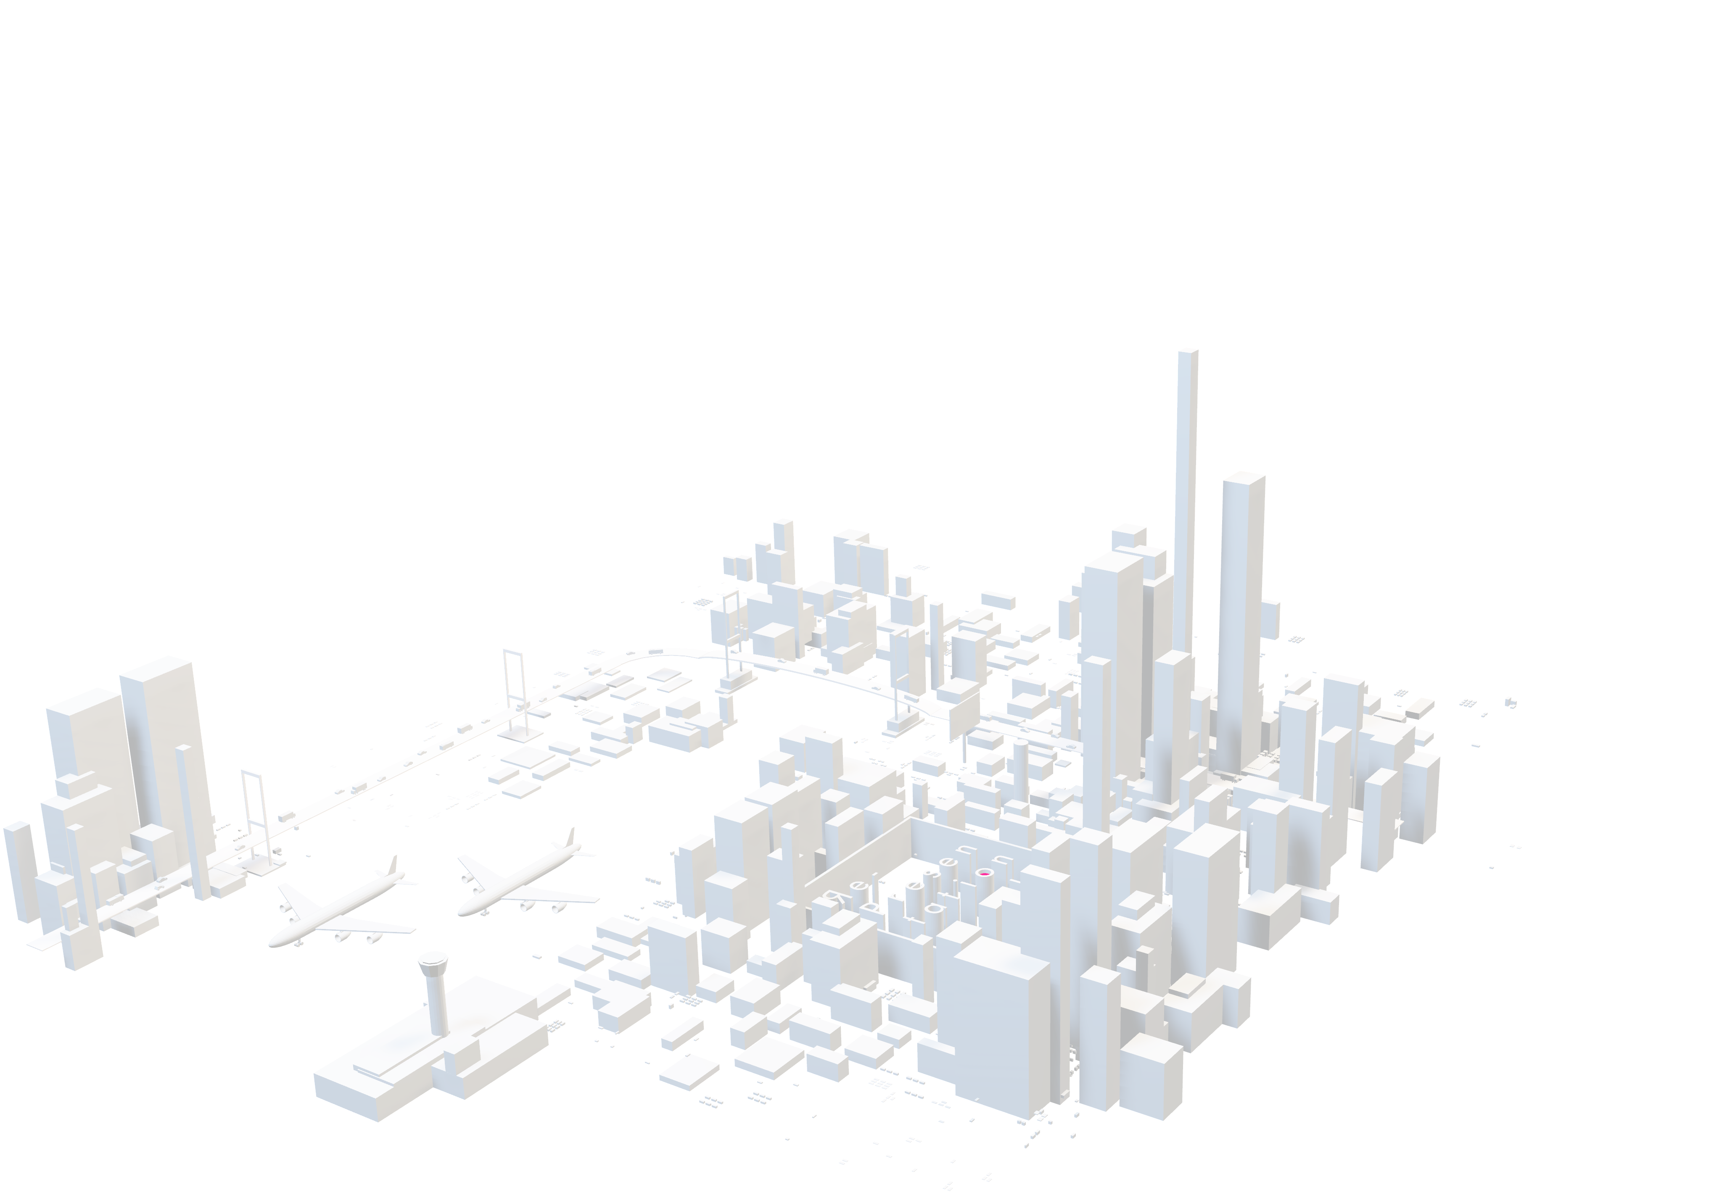
Billboard
WORLD OF ADVERTISING
SPACIAL SLIDE DECK
WITH LOW POLY 3D ASSETS

Slide 4
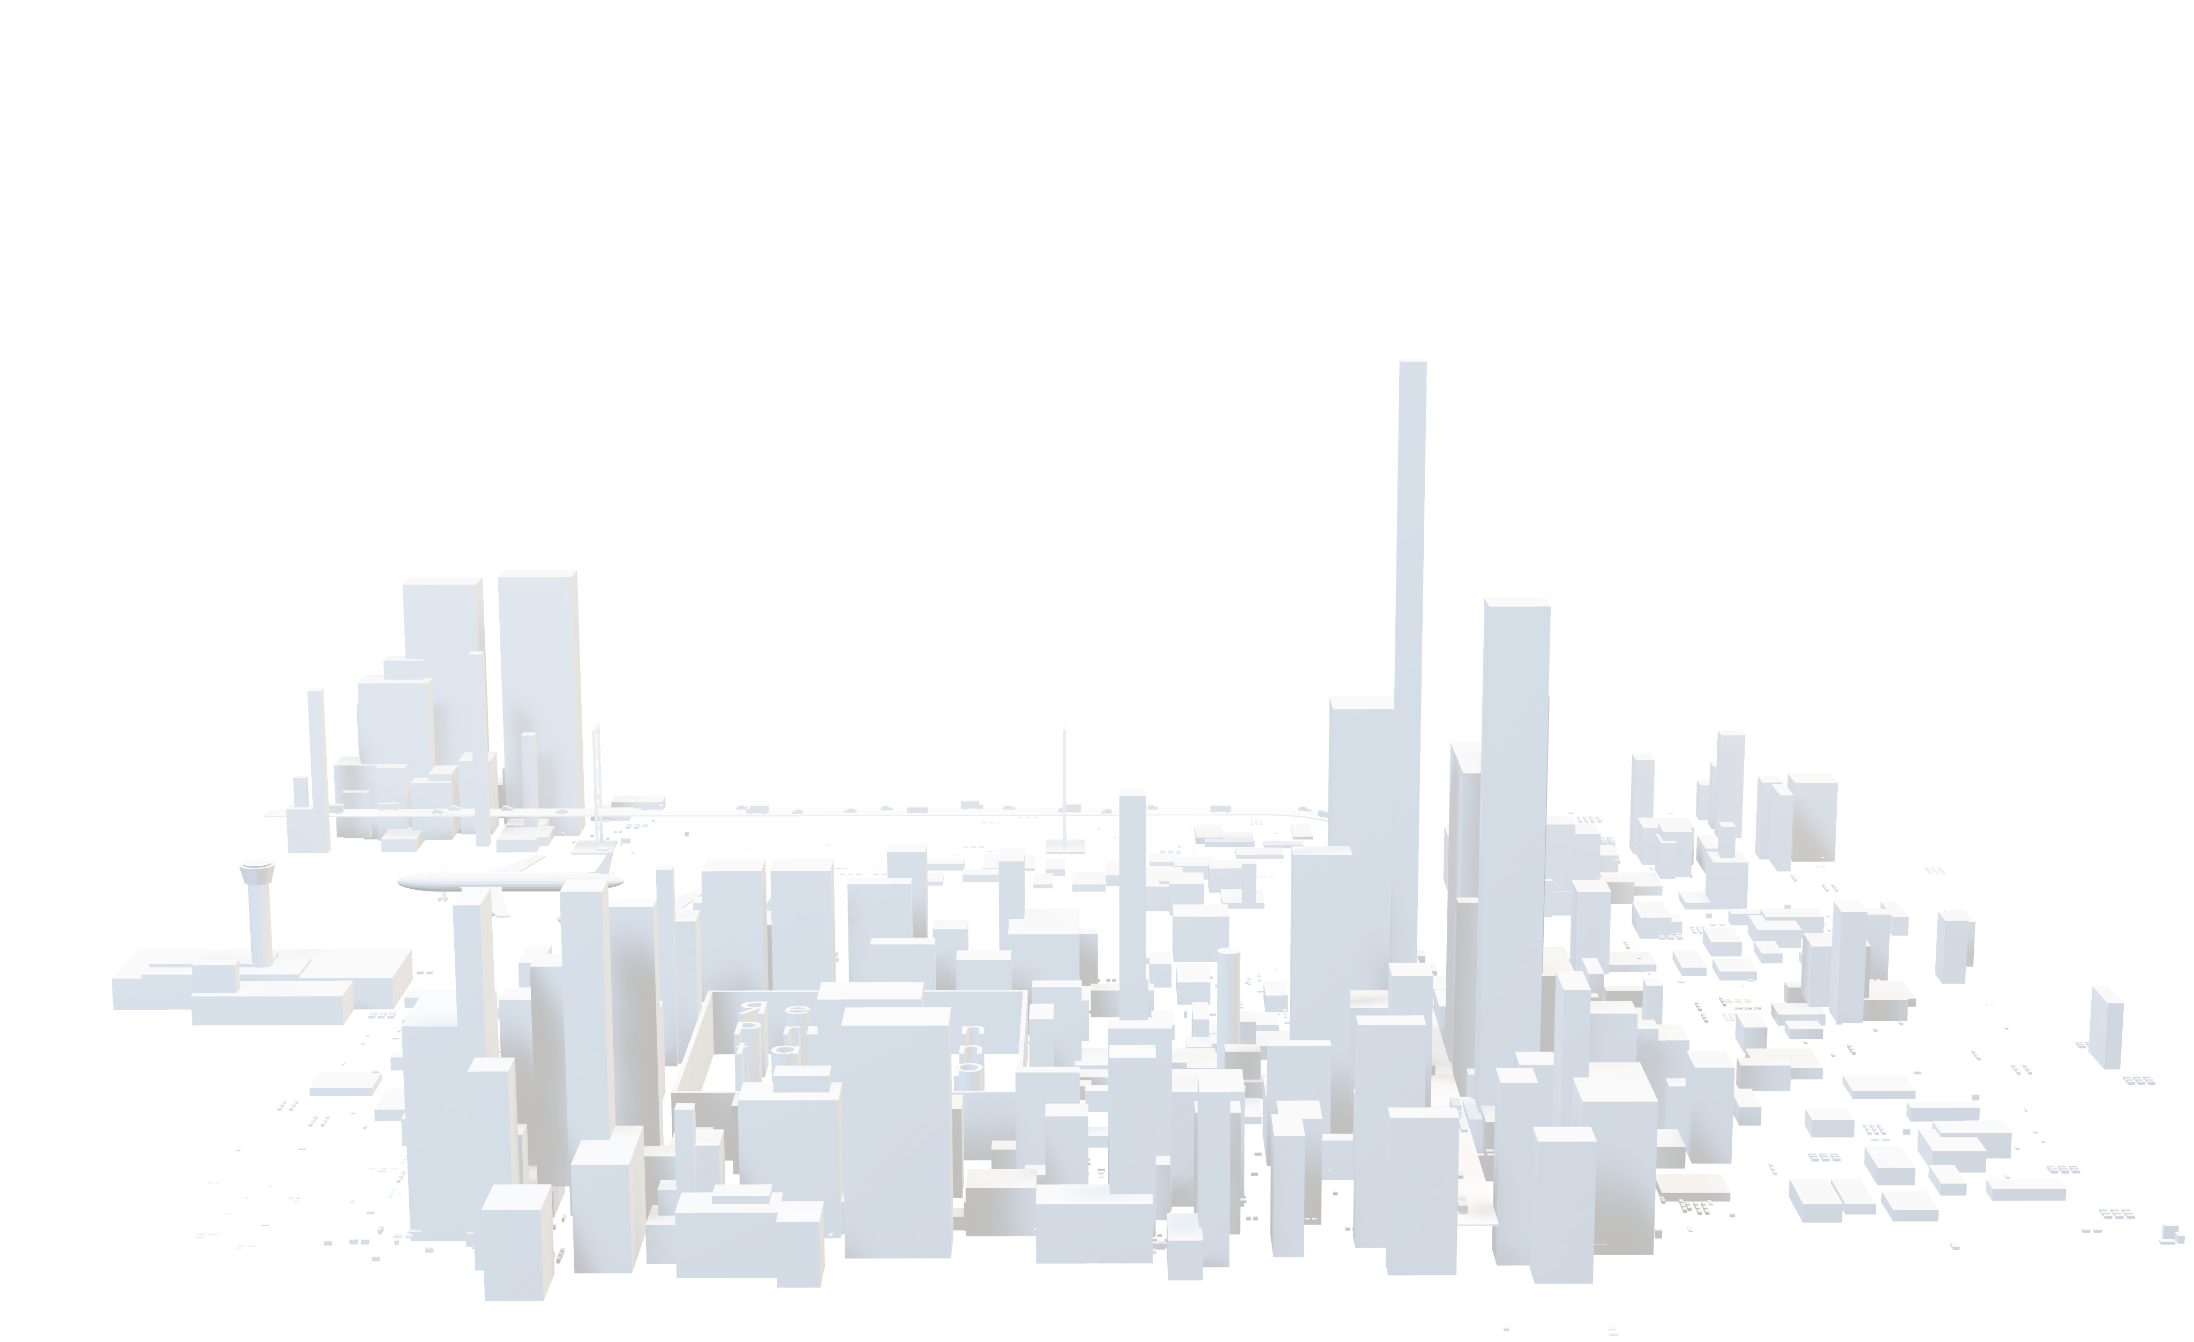
Vehicle Advertising
WORLD OF ADVERTISING
SPACIAL SLIDE DECK
WITH LOW POLY 3D ASSETS

Slide 5
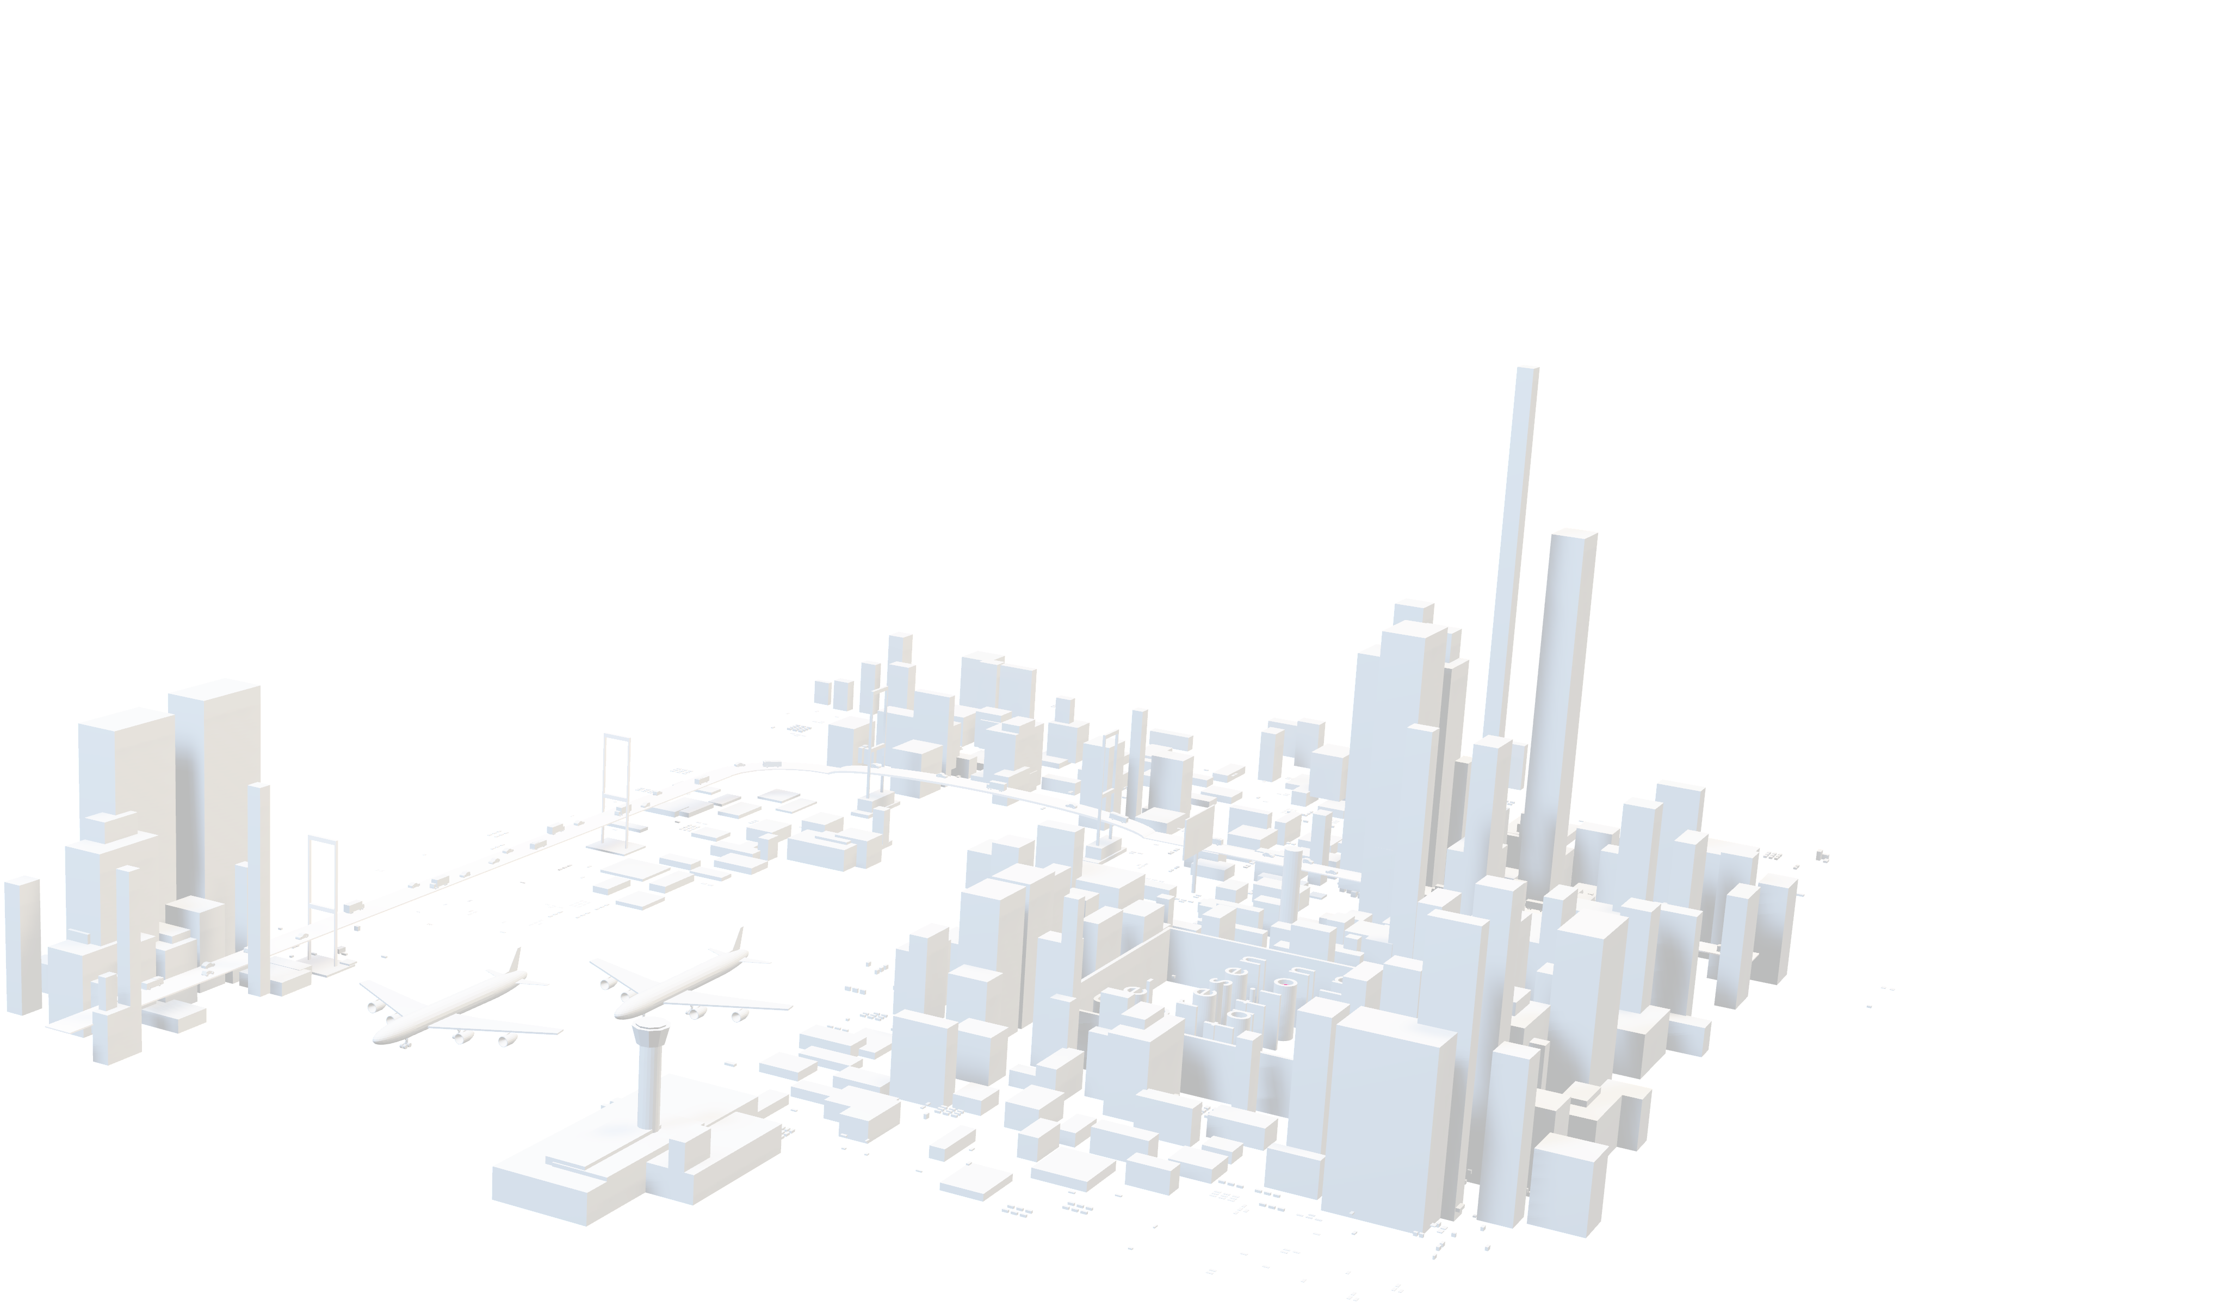
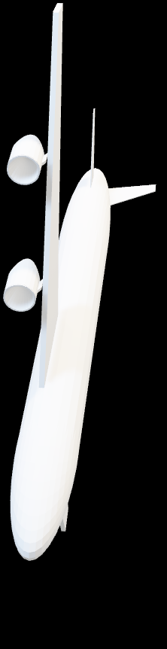
Promotional Aircraft
WORLD OF ADVERTISING
SPACIAL SLIDE DECK
WITH LOW POLY 3D ASSETS

Slide 6
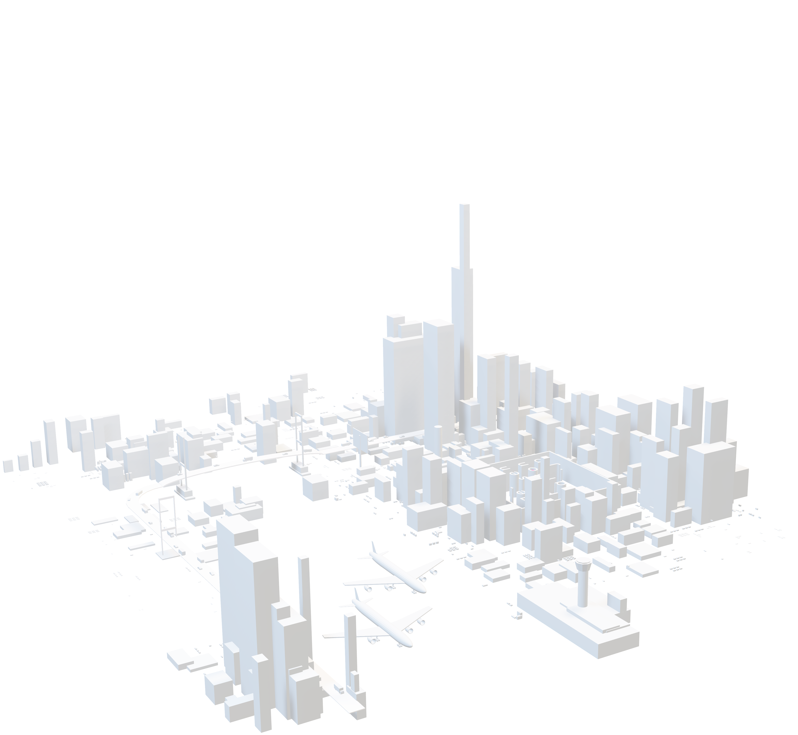
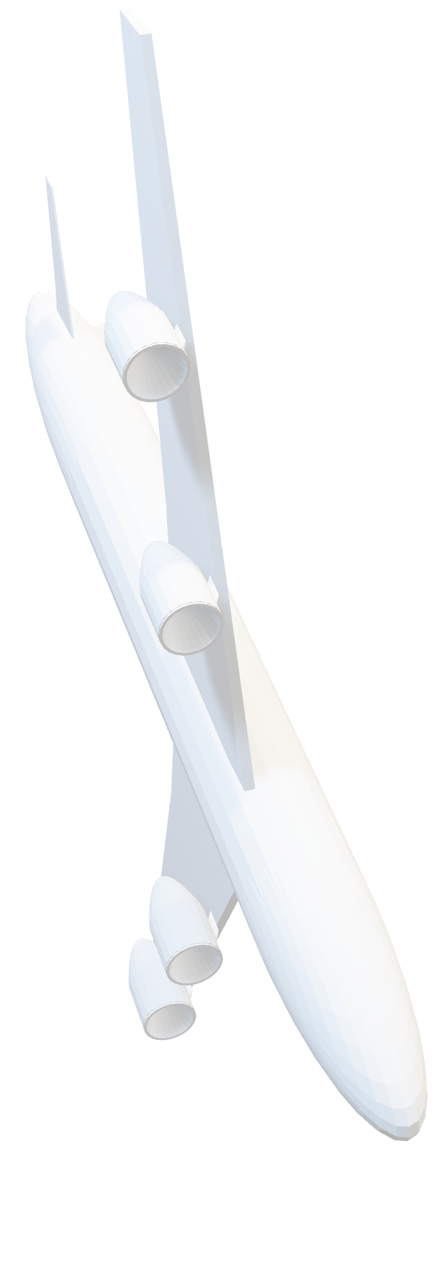
3D CITY
WORLD OF ADVERTISING
SPACIAL SLIDE DECK
WITH LOW POLY 3D ASSETS

Slide 7
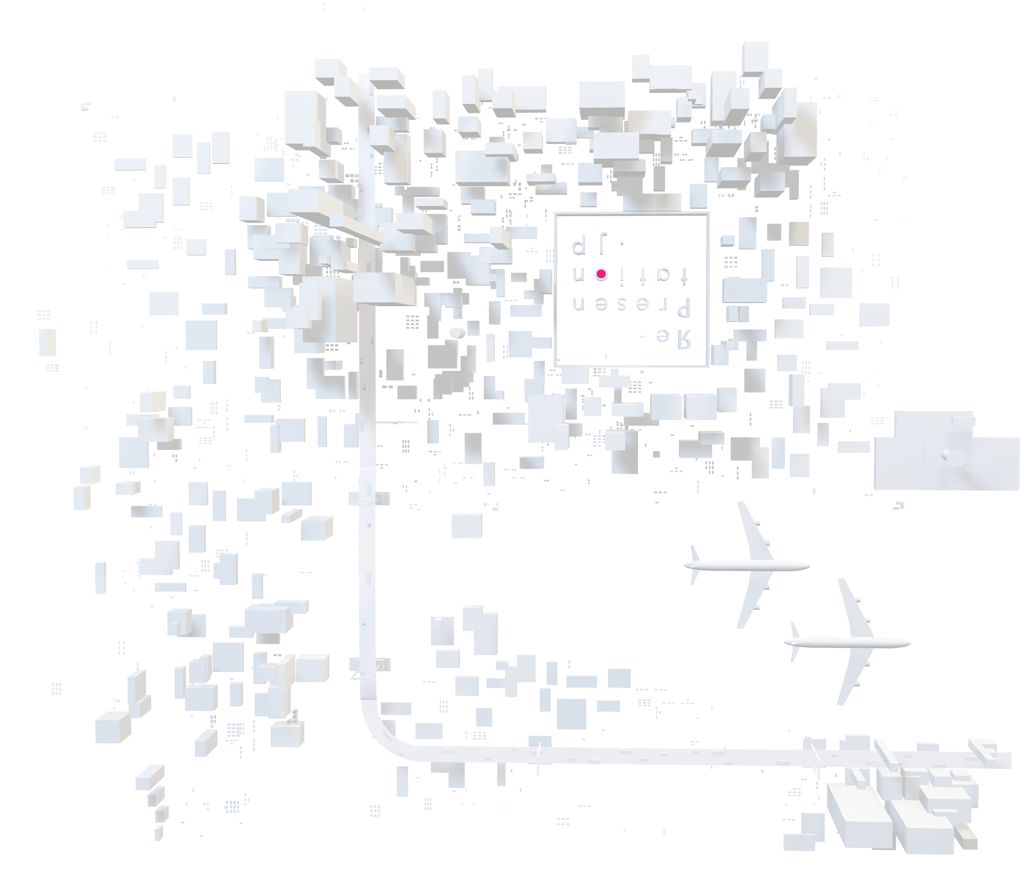
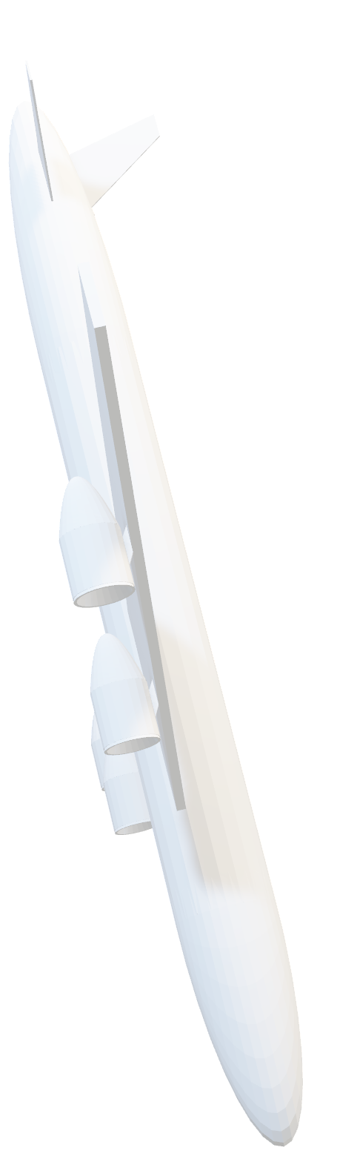

Slide 8

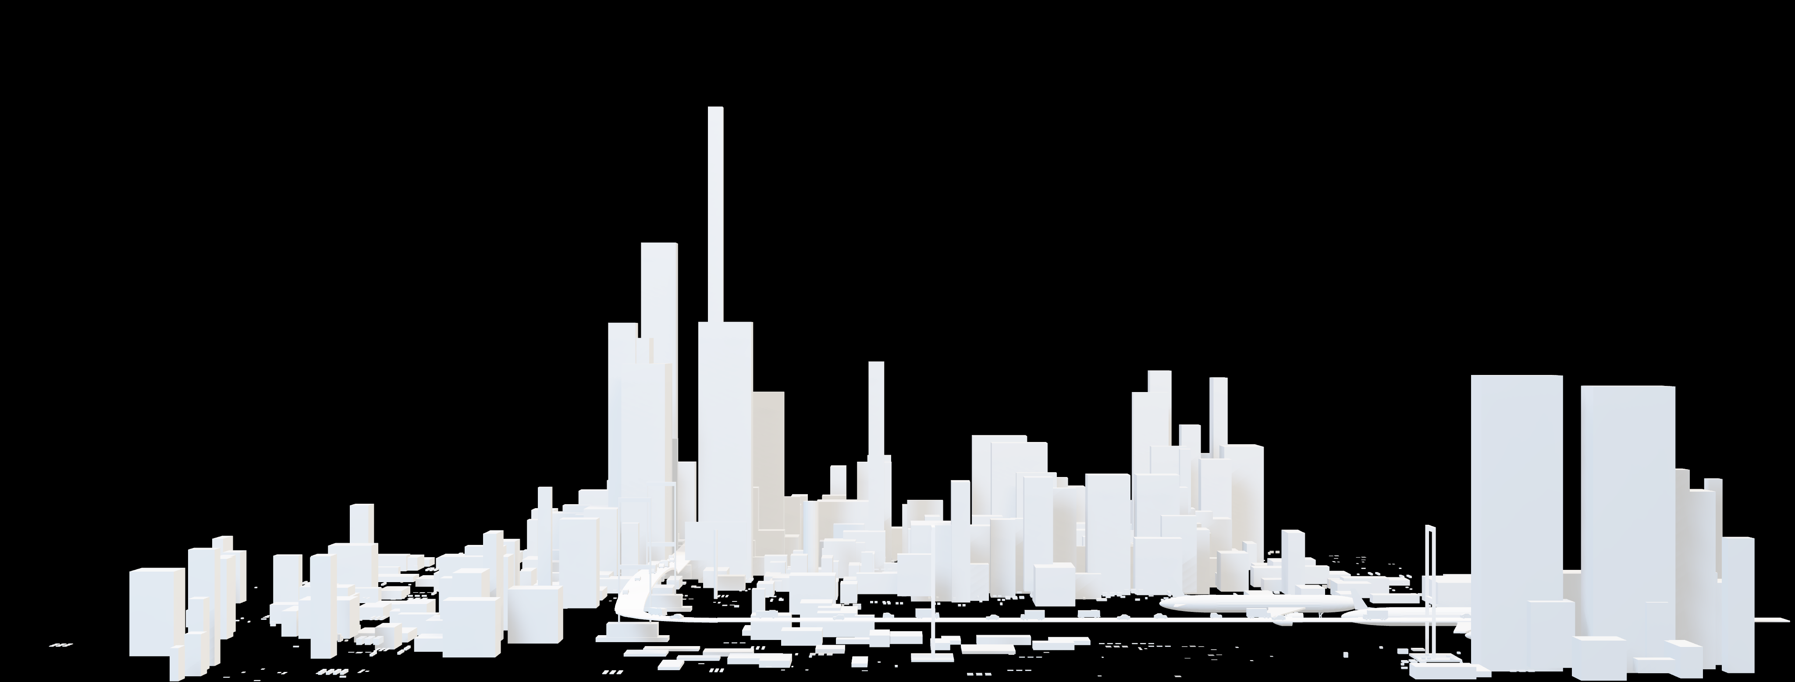


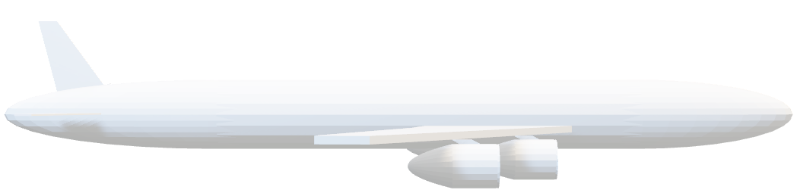


3D CITY ASSETS

